Slide 1
"Turning Mobile Market Data into Business Opportunities"
Insights and Strategies for Growth in the Smartphone Industry

Slide 2
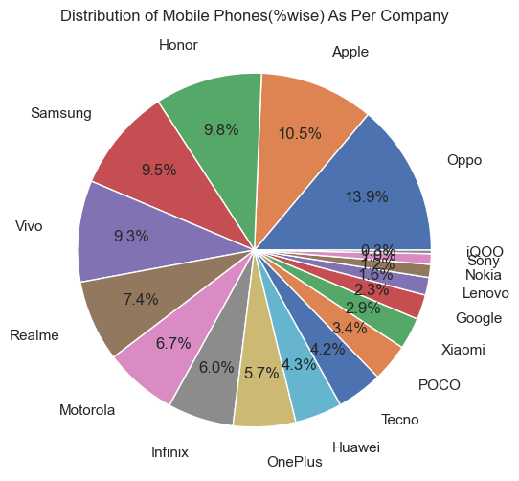

Slide 3
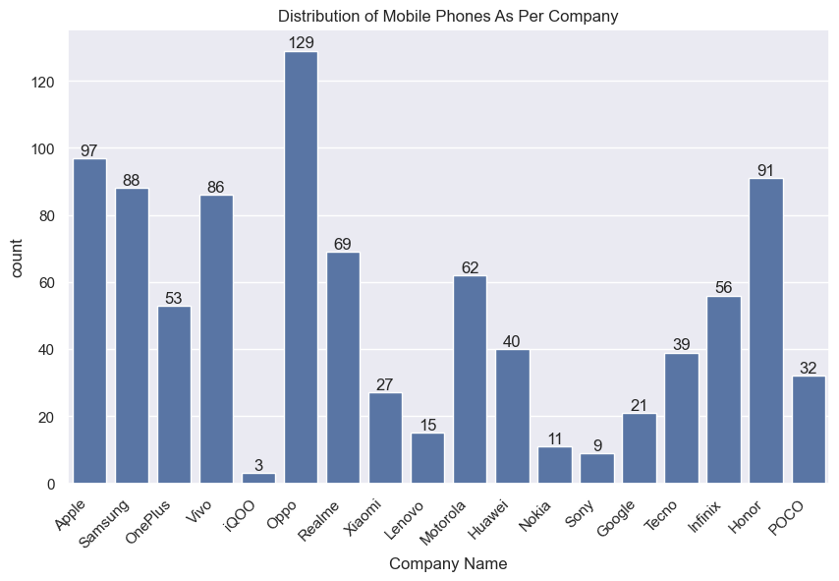
Total Number of Mobile Phone=928

Slide 4
More number of Mobile Distribution is in:-
1.Oppo
2.Apple
3.Honor
4.Samsung
5.Vivo
These 5 companies are dominating according to dataset

Slide 5
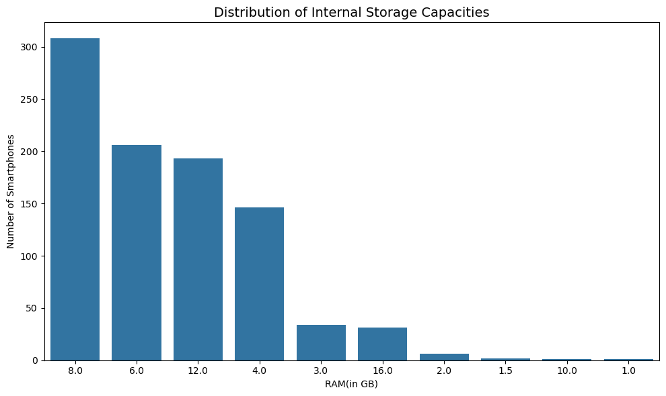
More than 300 mobile phone have 8GB RAM
In Between(150 to 200) mobile phone have 6GB,12GB,4GB RAM

Slide 6
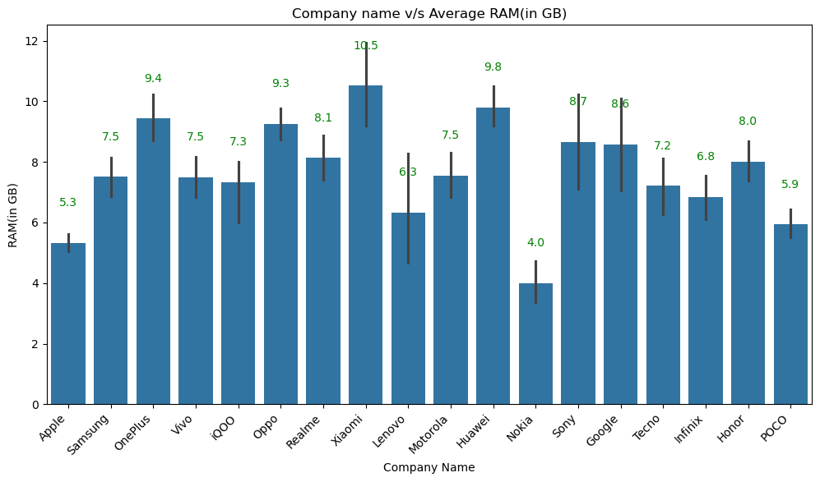

Slide 7
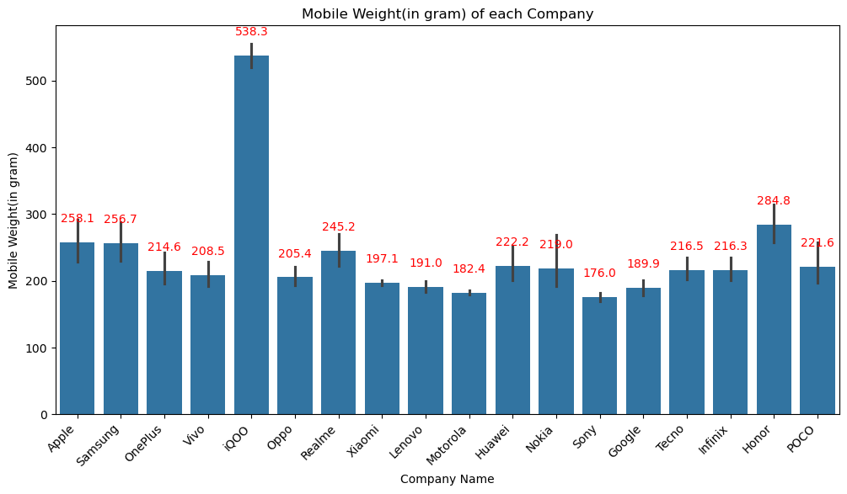

Slide 8
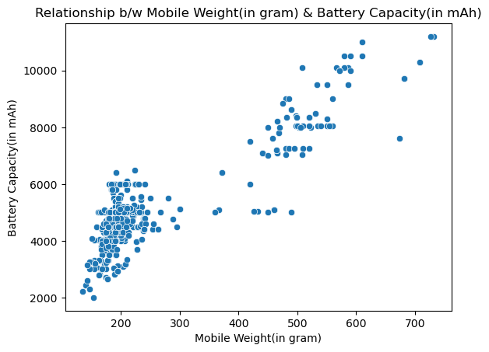

Slide 9
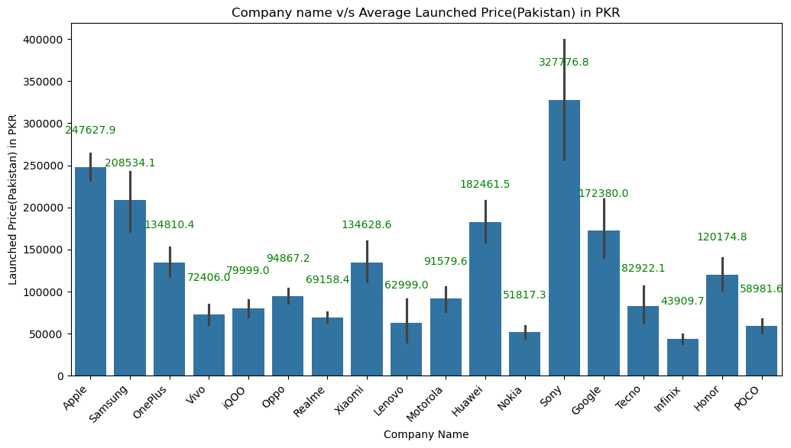

Slide 10
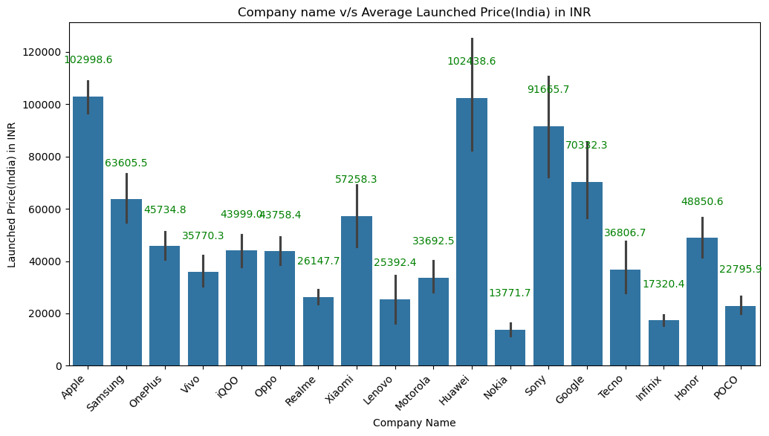

Slide 11
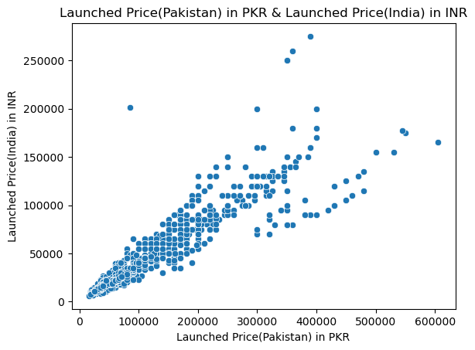

Slide 12
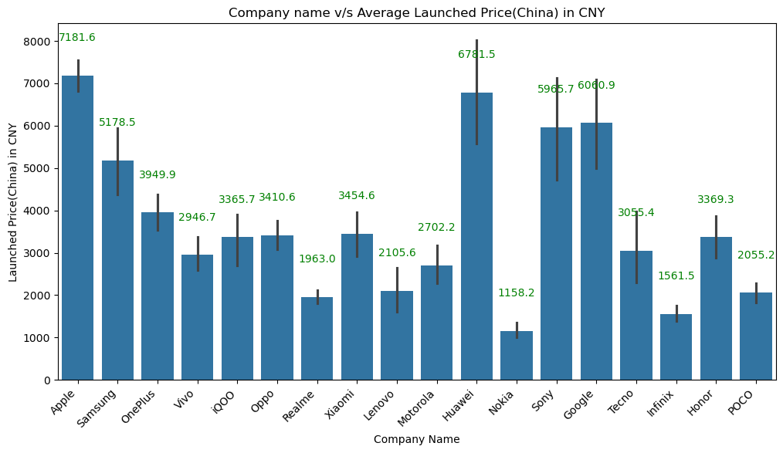

Slide 13
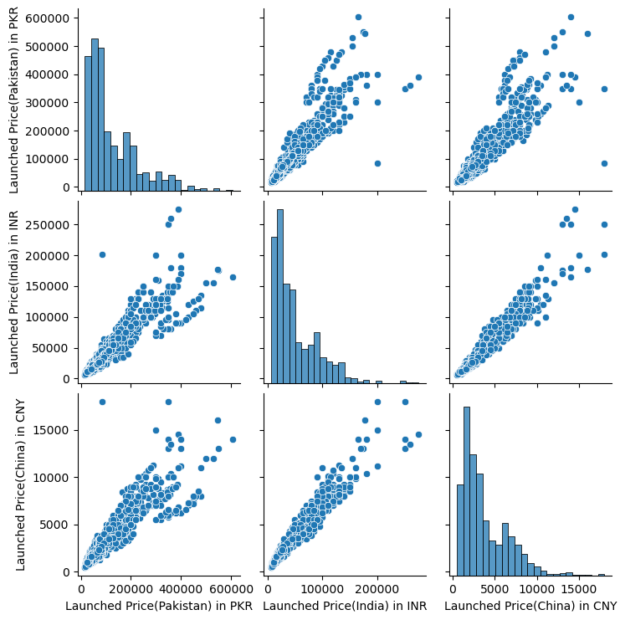

Slide 14
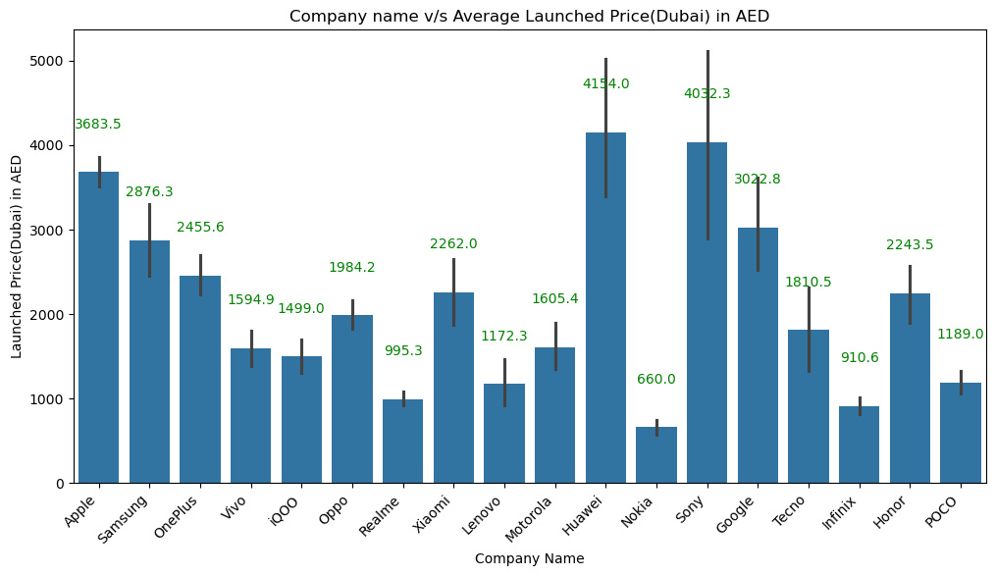

Slide 15
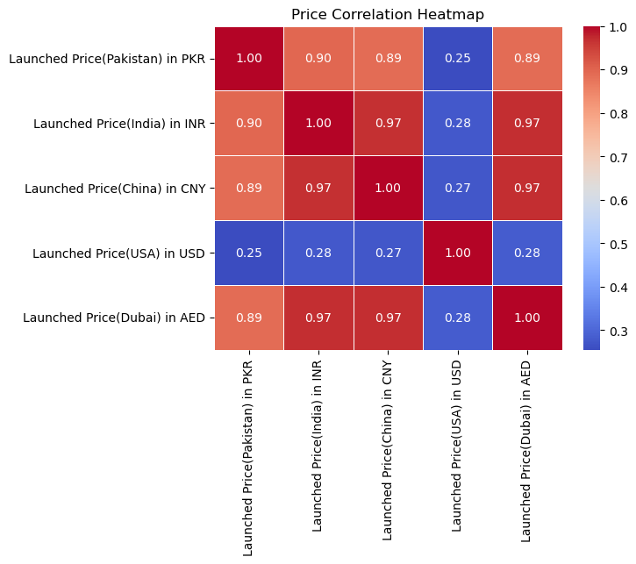

Slide 16
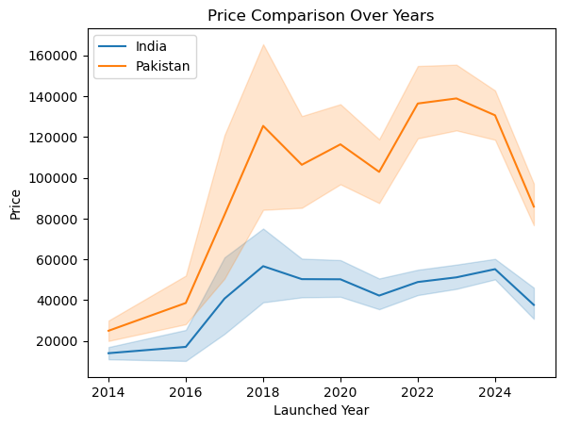

Slide 17
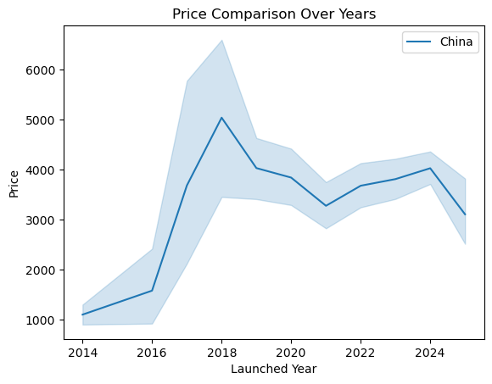

Slide 18
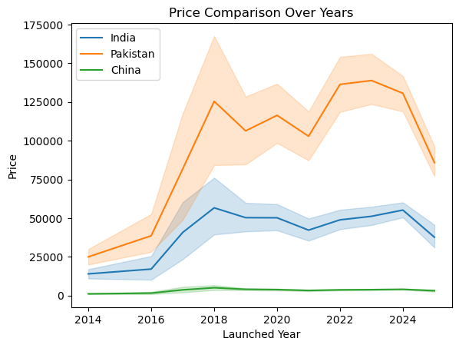

Slide 19
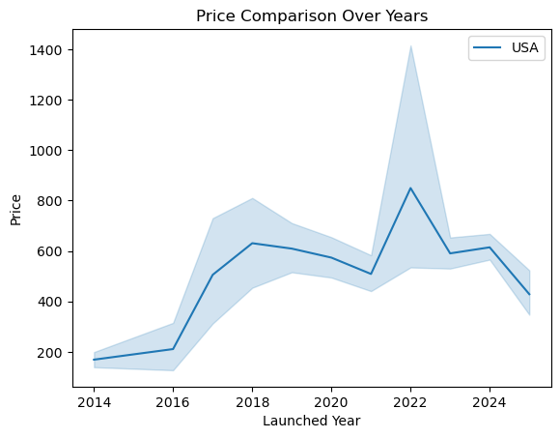

Slide 20
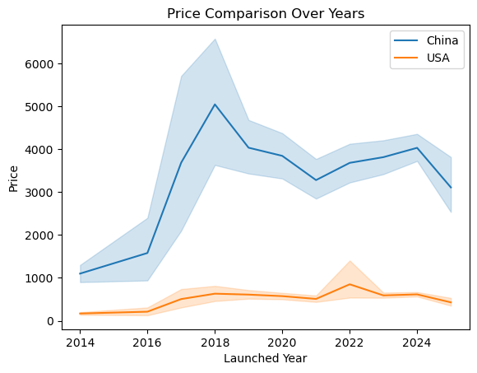

Slide 21
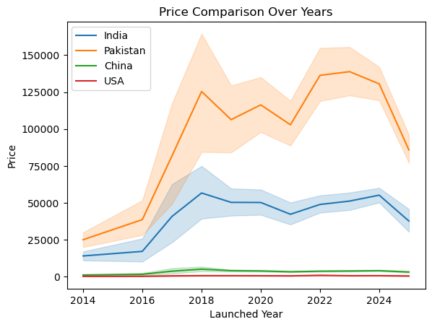

Slide 22
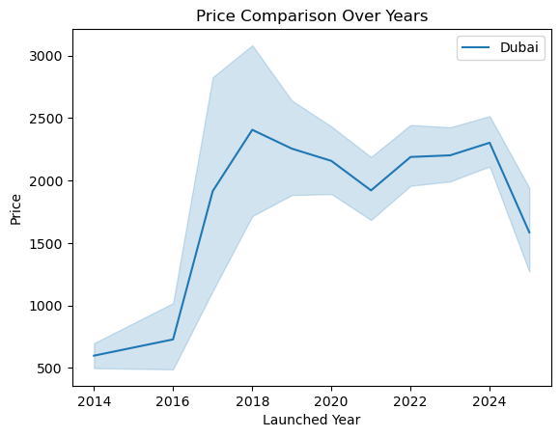

Slide 23
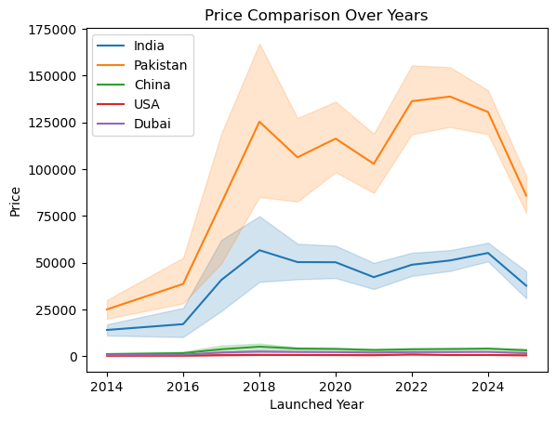

Slide 24
Conclusion:
Mobile prices in Pakistan, India, and China are quite similar and move in the same direction.
Companies are using almost the same pricing strategy in these countries.
Similar prices may be due to customer needs, competition, and production costs being alike.
8GB RAM mobiles are the most popular among buyers.
Oppo, Apple, Honor, Samsung, and Vivo dominate the market.
Brands can launch products and set prices at the same time in these markets to get better sales and save costs.

